Slide 1
Predicting Disease Outbreaks with Health and Environmental Data
Final Project
Arangarajan Vinayagam

Slide 2
Problem Statement
Create a predictive model to classify regions based on a disease outbreak
Group them into clusters based on the outbreak risk level
Provide high level recommendations, based on the identified insights on regions with high outbreak probability

Slide 3
Step 1: Data Preprocessing
Load and read dataset (1. disease outbreak data and 2. Synthetic hospital readmissions data)
Data Cleaning:: Address missing or inconsistent values in demographic, environmental, and health data.
# Fill missing values for numeric columns with the mean
data[numeric_cols] = data[numeric_cols].fillna(data[numeric_cols].mean())
# Fill missing values for categorical columns with the mode
for col in categorical_cols: data[col] = data[col].fillna(data[col].mode()[0])
Encoding Categorical Variables: Encode categorical data (e.g., outbreak_risk_category) for compatibility with models.
Normalization/Scaling:: Standardize data to handle varying scales between numerical features.
# Normalize numerical columns
(numerical_columns = ['population_density', 'median_income’, 'vaccination_rate', 'avg_temperature','hospitals_per_100k', 'healthcare_accessibility_score', 'annual_rainfall', 'air_quality_index’])

Slide 4
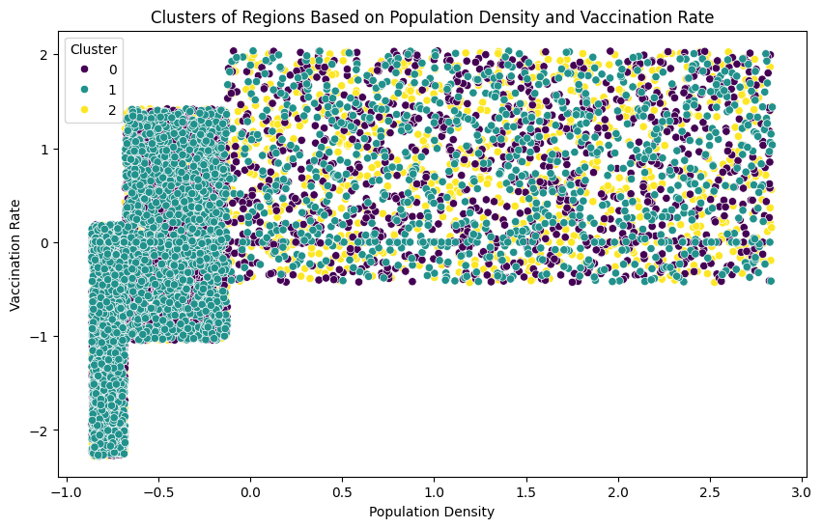
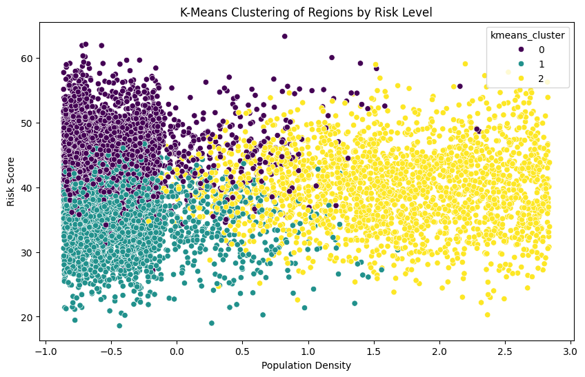
Step 2: Clustering Regions
K-means clustering: region based on population density and vaccination rate
K-means clustering: regions by Risk Level
Evaluate K-Means using silhouette score
K-Means Silhouette Score: 0.14

Slide 5
Step 3: Classification Model for Outbreak Prediction:
Identified important features using Random Forest Algorithm
Top 10 Important Features considered for Model Training: Feature Importance
risk_score 0.675164
international_travel_freq 0.049422
avg_humidity 0.038839
air_quality_index 0.035382
outbreak_frequency_5years 0.032730
public_transport_usage 0.019400
healthcare_accessibility_score 0.014062
daily_commuter_percentage 0.010766
kmeans_cluster 0.009863
vaccination_rate 0.008947
Model Selection and trained with important reatures
Random Forest
MLP Neural network
Logistic Regression
Naïve Bayes
KNN Classifier
SVM Classifier

Slide 6
Step 3: Classification Model for Outbreak Prediction:
Model Evaluation
The classifiers are trained and evaluated the following performance metrics: Accuracy, Precision, F1-Measure, and Recall
First the Random Forest model is trained with existing data features and got unbalanced class results as follows:
Confusion Matrix
ROC-AUC Score: 1.0000
 | Class 0 | Class 1 | Class 2
Class 0 | 1 | 0 | 0
Class 1 | 0 | 85 | 0
Class 2 | 0 | 0 | 1914
Observed Outcomes: Class Imbalance
The presence of a small number of samples for Class 0 (only 1) and Class 1 (85 samples) compared to Class 2 (1914 samples) could suggest that the dataset is imbalanced.
While the model classifies the classes well, the small number of samples in the minority classes may not provide enough variance or complexity for the model to learn in a real-world scenario.
Class imbalance can lead to bias, where the model could be favoring the majority class (Class 2) while performing very well on the minority classes due to their simple and small nature.

Slide 7
Step 3: Classification Model for Outbreak Prediction:
Apply SMOTE technique (with Random Forest Classifier)
SMOTE (Synthetic Minority Over-sampling Technique) is a popular technique used to address the issue of class imbalance by generating synthetic samples for the minority class.
Over all Classification Accuracy = 100 %
Observed Outcomes:
Class 0: True Positives: 1881, False Positives: 0, False Negatives: 0, True Negatives: 3792
Precision: 1.0000 Recall: 1.0000 F1-Score: 1.0000
Class 1: True Positives: 1885, False Positives: 0, False Negatives: 0, True Negatives: 3788
Precision: 1.0000 Recall: 1.0000 F1-Score: 1.0000
Class 1: True Positives: 1907, False Positives: 0, False Negatives: 0, True Negatives: 3766
Precision: 1.0000 Recall: 1.0000 F1-Score: 1.0000
ROC-AUC Score: 1.0000
Confusion Matrix
 | Class 0 | Class 1 | Class 2
Class 0 | 1881 | 0 | 0
Class 1 | 0 | 1885 | 0
Class 2 | 0 | 0 | 1907
In conclusion, the application of SMOTE in this case has significantly improved the model's performance by balancing the class distribution

Slide 8
Step 3: Classification Model for Outbreak Prediction:
MLP Classifier
Over all Classification Accuracy = 99.51 %
Observed Outcomes:
Class 0 - Precision: 0.9989, Recall: 1.0000, F1-score: 0.9995
Class 1 - Precision: 0.9937, Recall: 1.0000, F1-score: 0.9968
Class 2 - Precision: 1.0000, Recall: 0.9927, F1-score: 0.9963
ROC-AUC Score: 0.999
Confusion Matrix
 | Class 0 | Class 1 | Class 2
Class 0 | 1881 | 0 | 0
Class 1 | 0 | 1885 | 0
Class 2 | 0 | 0 | 1893

Slide 9
Step 3: Classification Model for Outbreak Prediction:
Logistic Regression
Over all Classification Accuracy = 99.53 %
Observed Outcomes:
Class 0 - Precision: 0.9995, Recall: 1.0000, F1-score: 0.9997
Class 1 - Precision: 0.9952, Recall: 1.0000, F1-score: 0.9976
Class 2 - Precision: 1.0000, Recall: 0.9948, F1-score: 0.9974
ROC-AUC Score: 0.999
Confusion Matrix
 | Class 0 | Class 1 | Class 2
Class 0 | 1881 | 0 | 0
Class 1 | 0 | 1885 | 0
Class 2 | 1 | 9 | 1897

Slide 10
Step 3: Classification Model for Outbreak Prediction:
Naive Bayes
Over all Classification Accuracy = 97.1 %
Observed Outcomes:
Class 0 - Precision: 0.9984, Recall: 1.0000, F1-score: 0.9992
Class 1 - Precision: 0.9509, Recall: 0.9756, F1-score: 0.9631
Class 2 - Precision: 0.9752, Recall: 0.9486, F1-score: 0.9617
ROC-AUC Score: 0.9512
Confusion Matrix
 | Class 0 | Class 1 | Class 2
Class 0 | 1881 | 0 | 0
Class 1 | 0 | 1839 | 46
Class 2 | 3 | 95 | 1809

Slide 11
Step 3: Classification Model for Outbreak Prediction:
KNN Classifier
Over all Classification Accuracy = 98.06 %
Observed Outcomes:
Class 0 - Precision: 0.9973, Recall: 1.0000, F1-score: 0.9987
Class 1 - Precision: 0.9593, Recall: 1.0000, F1-score: 0.9792
Class 2 - Precision: 1.0000, Recall: 0.9554, F1-score: 0.9772
ROC-AUC Score: 0.980
Confusion Matrix
 | Class 0 | Class 1 | Class 2
Class 0 | 1881 | 0 | 0
Class 1 | 0 | 1885 | 0
Class 2 | 5 | 80 | 1822

Slide 12
Step 3: Classification Model for Outbreak Prediction:
SVM Classifier
Over all Classification Accuracy = 98.15%
Observed Outcomes:
Class 0 - Precision: 0.9979, Recall: 1.0000, F1-score: 0.9989
Class 1 - Precision: 0.9672, Recall: 1.0000, F1-score: 0.9833
Class 2 - Precision: 1.0000, Recall: 0.9643, F1-score: 0.9818
ROC-AUC Score: 0.984
Confusion Matrix
 | Class 0 | Class 1 | Class 2
Class 0 | 1881 | 0 | 0
Class 1 | 0 | 1885 | 0
Class 2 | 4 | 64 | 1839

Slide 13
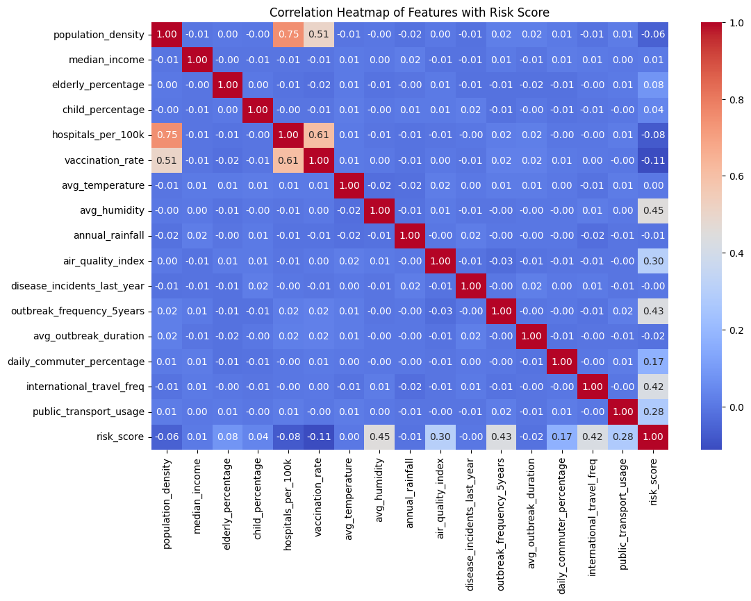
Step 4: Insights & Visualization::
Heatmap: Risk score
distribution across regions

Slide 14
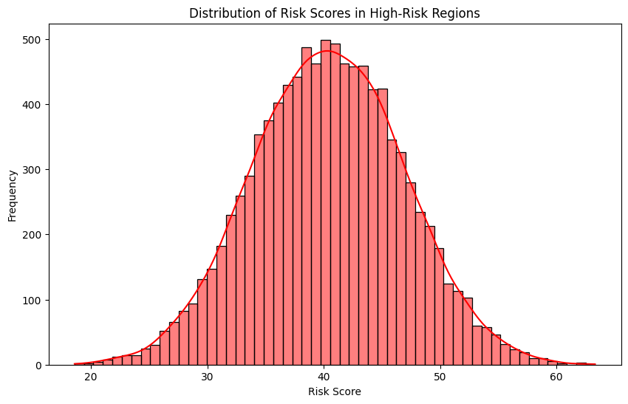
Step 4: Insights & Visualization::
Risk score on high risk regions and Correlation heat map of key features
Risk score Distribution on high risk regions

Slide 15
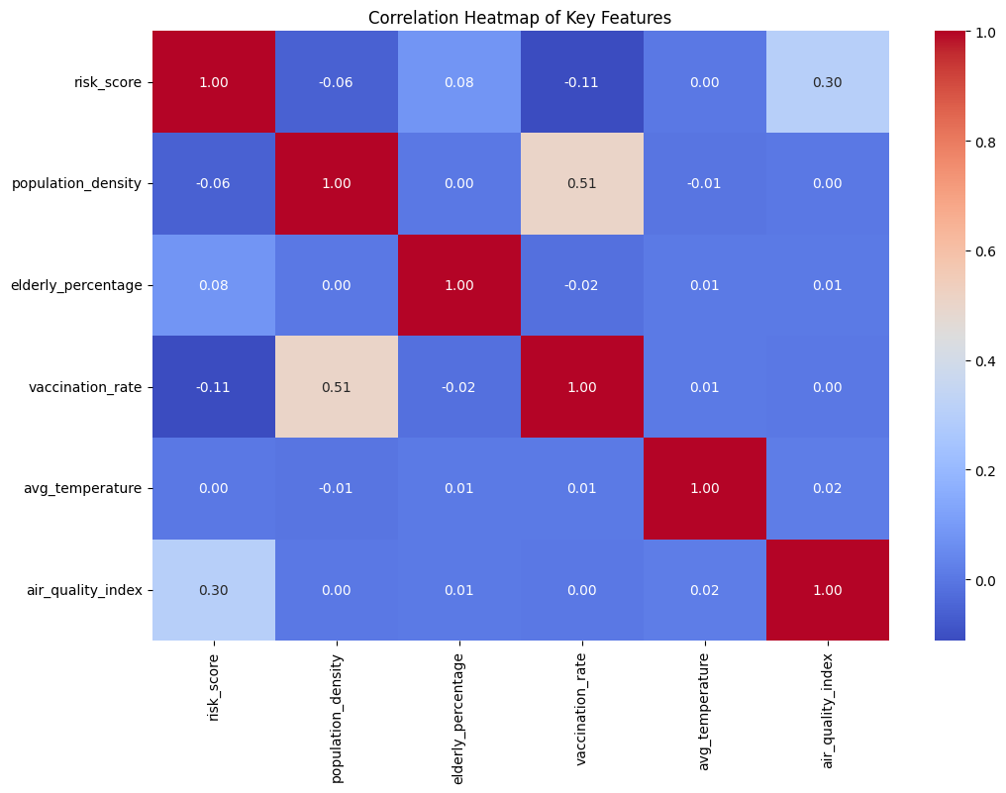
Step 4: Insights & Visualization::
Risk score on high risk regions and Correlation heat map of key features
Correlation heat map of key features

Slide 16
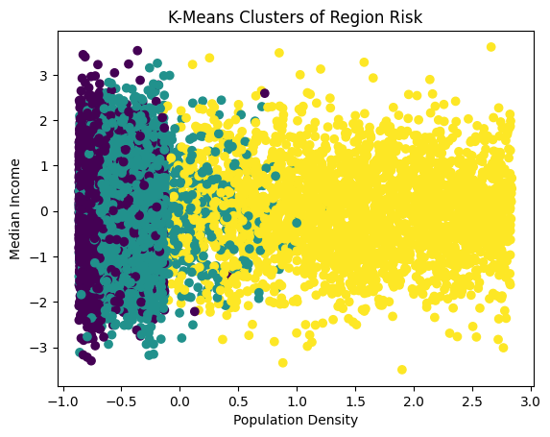
Step 4: Insights & Visualization::
Risk score on high risk regions and Correlation heat map of key features
Visualize the clusters and identify patterns based on two key features: population density and median_income

Slide 17
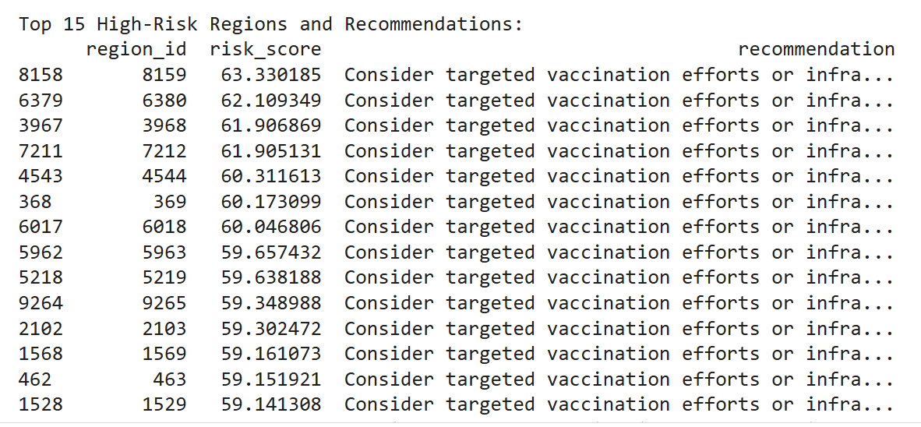
Step 5: Results & Final Conclusion
Identifying high-risk regions and actionable recommendations

Slide 18
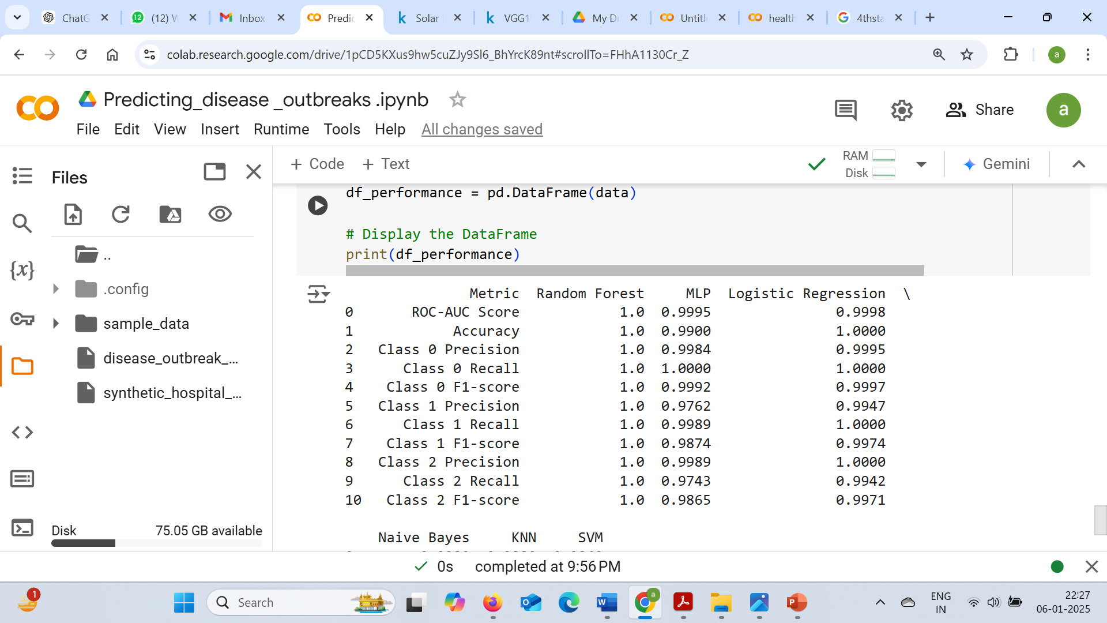
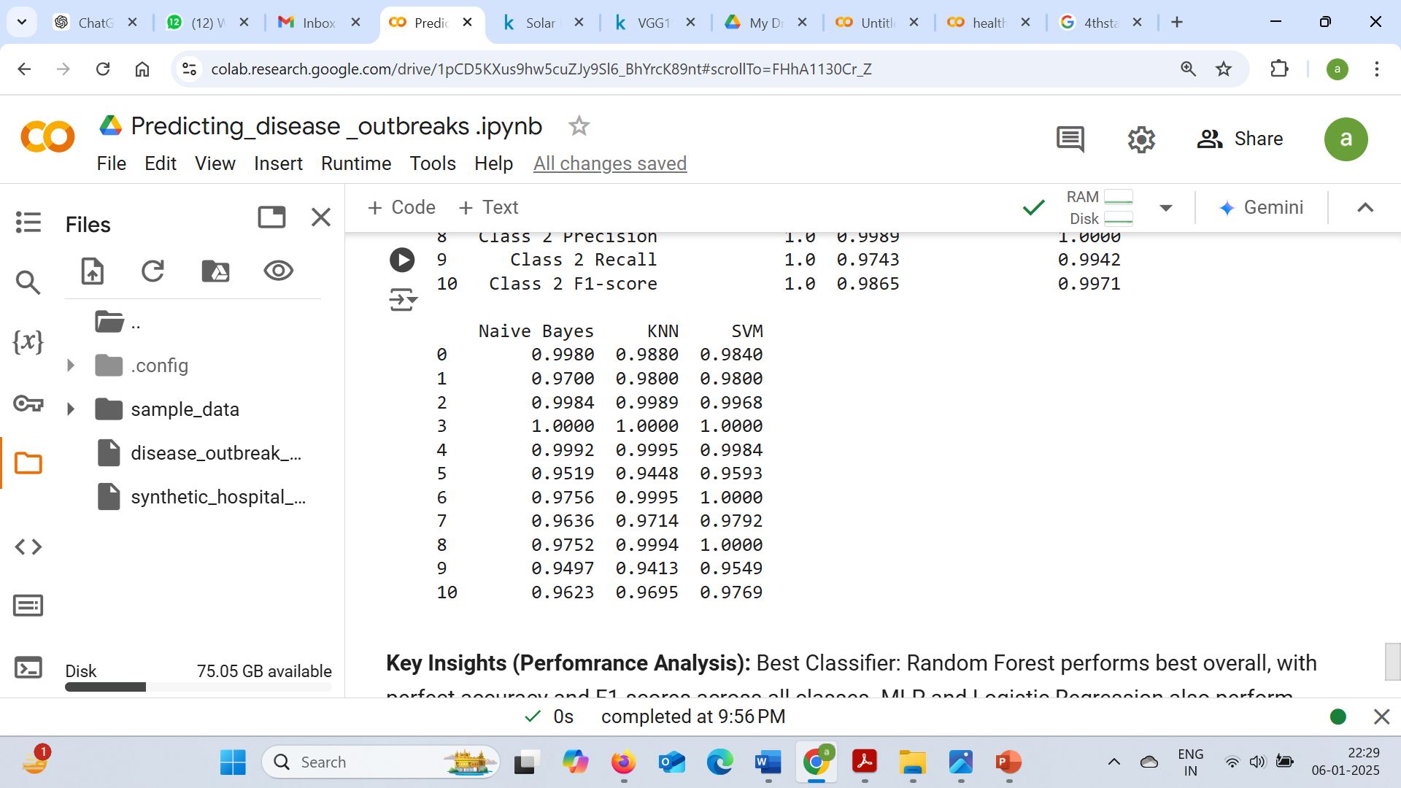
Step 5: Results & Final Conclusion
Performance Summary of Different ML Classifiers
Key Insights (Perfomrance Analysis):
Best Classifier: Random Forest performs best overall, with perfect accuracy and F1-scores across all classes.
MLP and Logistic Regression also perform excellently, with very high ROC-AUC scores and near-perfect metrics.
Naive Bayes, KNN, and SVM show slightly lower accuracy but still demonstrate good performance across classes, especially in terms of precision and recall for Class 0.

Slide 19
Step 5: Results & Final Conclusion
Actionable Insights (Based on Performance Outcomes):
For applications requiring the highest accuracy and model confidence, the Random Forest classifier is the best choice due to its perfect performance across all metrics. If computational efficiency is a concern and high performance is still needed,
MLP or Logistic Regression would be the next best choices.
Naive Bayes, KNN, and SVM provide strong performance but may struggle with certain class imbalances and slightly lower overall accuracy compared to the other models.
Random Forest
ROC-AUC Score 1.0
Accuracy 1.0
MLP
ROC-AUC Score 0.999
Accuracy 0.9951
Logistic Regression
ROC-AUC Score 0.995
Accuracy 0.999
Naive Bayes
ROC-AUC Score 0.9512
Accuracy 0.971
KNN
ROC-AUC Score 0.980
Accuracy 0.9806
SVM
ROC-AUC Score 0.984
Accuracy 0.9815

Slide 20
Step 5: Results & Final Conclusion
Key Insights from Cluster Analysis:
Cluster analysis identified regions at higher outbreak risk, highlighting the impact of vaccination rates, population density, and environmental factors like air quality.
High-risk areas often have lower vaccination rates and higher population densities, with varying environmental conditions affecting risk.
Potential Limitations:
Data Quality: Missing data and incomplete variables can affect the model’s accuracy.
Model Assumptions: Homogeneity within clusters may not always apply, and key variables might be overlooked.
Temporal Factors: Historical data may not reflect current trends in health dynamics.
Continuous Model Improvement:
Incorporate additional socio-economic and real-time data.
Use adaptive clustering methods and interpretable models to enhance accuracy and relevance.
Regular validation and expert feedback are necessary for continuous model refinement.

Slide 21
Thank You

